Slide 1
Data Understanding
Exploratory data analysis (EDA) using R and Data Visualization using Tableau

Slide 2
Analytical Approach
Descriptive vs Predictive:
Predictive Analytics (predict conversion rate based on user data)
Type of Learning:
Supervised Learning (Target variable ‘trial’ in Sample)
Type of Analysis:
Classification Analysis (Type of TV ‘trial’ is binary)
Regression Analysis (Type of TV ‘conversion rate’ is continuous)
Statistical Analysis (A/B Testing)
Success Measures:
Regression - R2 or MSE (Mean square error) etc
Classification – PCC (Percent correct classification), Confusion Matrix etc

Slide 3
Code Book
Data is structured, stored in flat files (.csv)
Data Structure: 346929 Observations of 11 variables.
Missing observations 350000 – 346929 = 3071
Data type of feature “trial” with value 0/1 is “int” instead of “factor”
Data Summary:
356 missing values of each feature “gender”, “age” & “industry_code”
9691 “Unknown” type of “payee”
Data Visualization:
Age (only numeric feature) is positive skewed = 0.74
Classification TV “Trial” is imbalance 0 – 329,713 & 1 - 17216

Slide 4
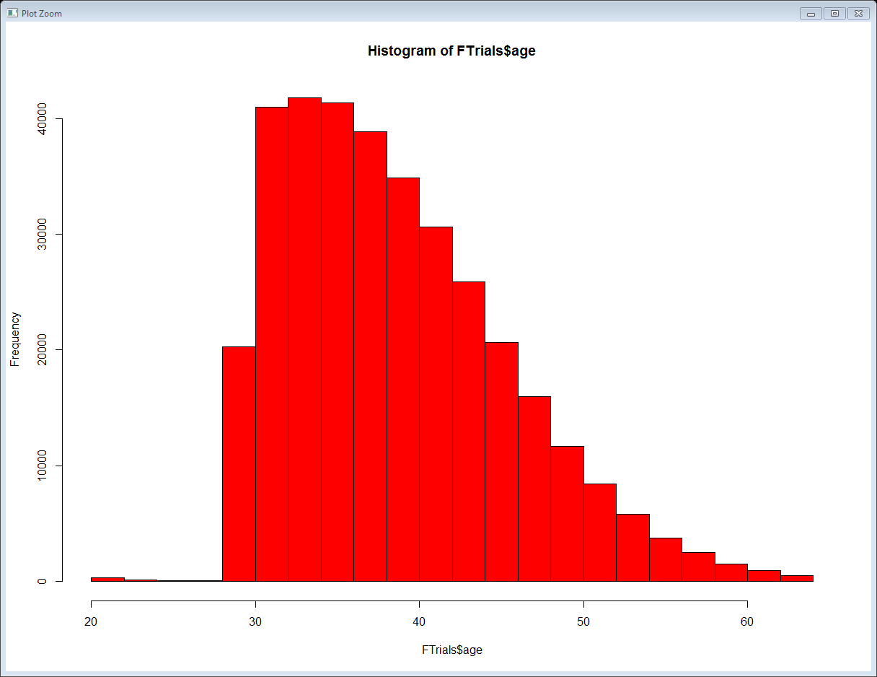
Data Visualization (Histogram)
Age is positive skewed (.74)
Outliers around Age of 21

Slide 5
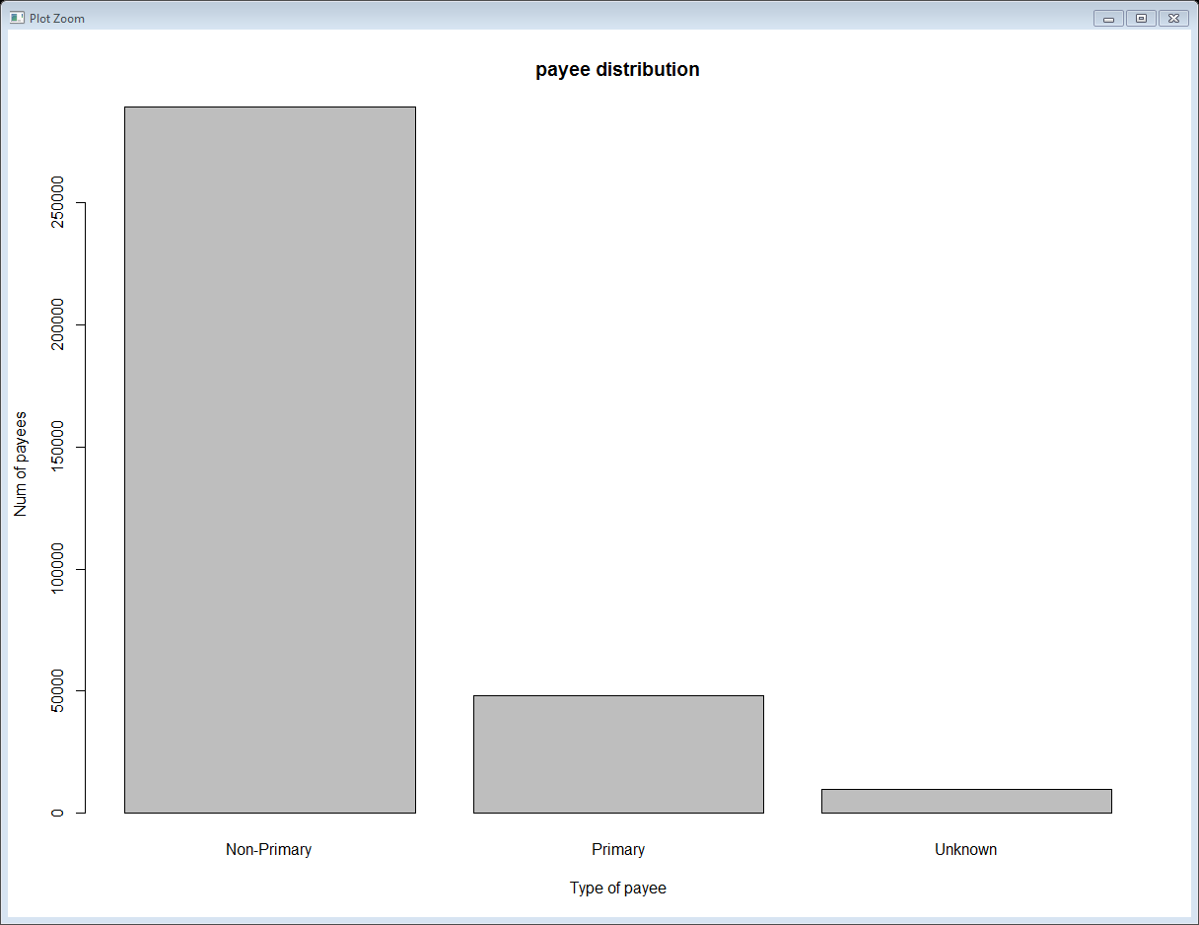
Data Visualization (Bar plot)
9691 “Unknown” type of “payee”

Slide 6
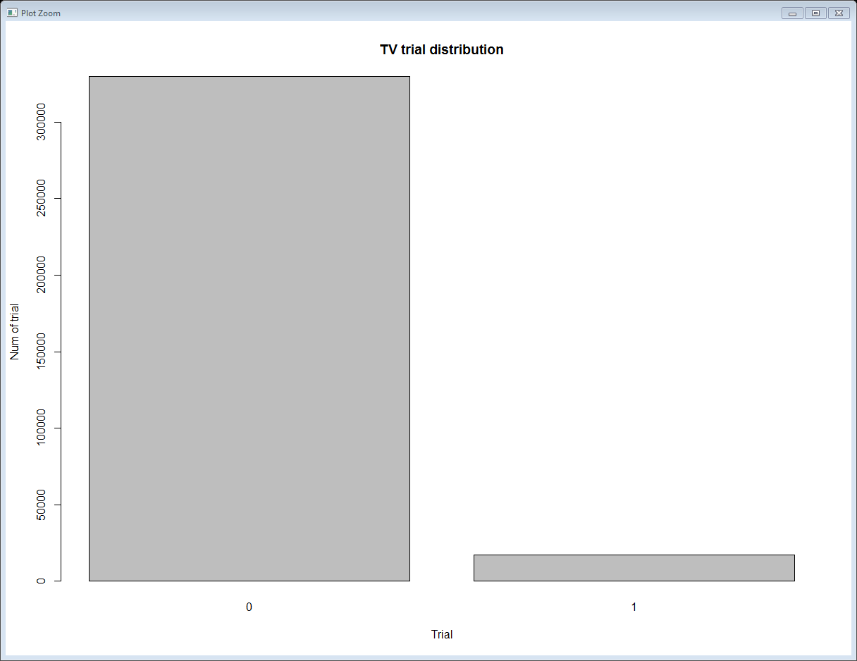
Data Visualization (Bar plot)
Classification Analysis, Binary TV “trial” is imbalance 0 – 329,713 1 – 17,216

Slide 7
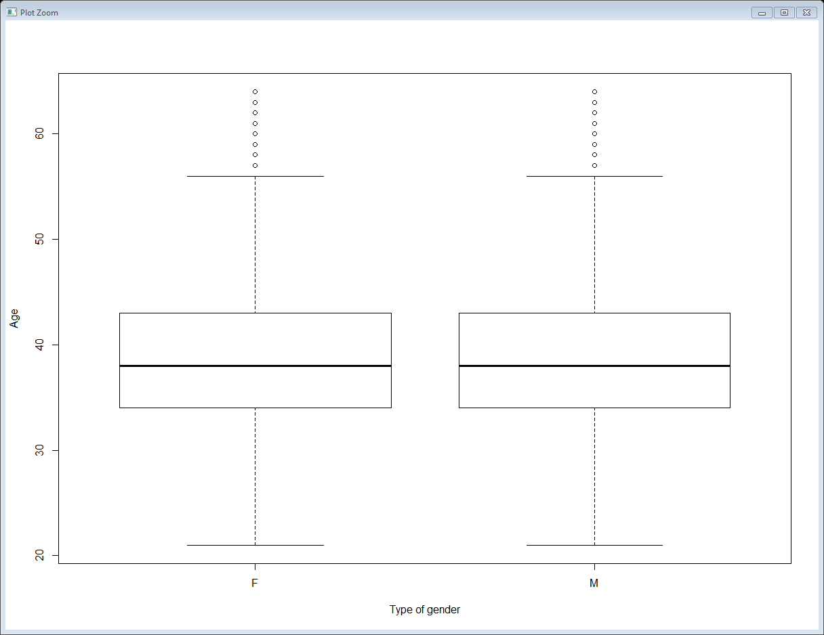
Data Visualization (Bar plot)
Numeric Age vs categorical gender (M/F)

Slide 8
How to fix Data Quality Issues
Issue: 3071 Missing observations
Fix: Live with it, sufficient observations 346,929
Issue: Target variable type incorrect “int”
Fix: convert to factor in R using factor(trial, level = c(0,1))
Issue: 356 Missing values of “gender”, “age” & “industry_code”
Fix: Ignore missing values, just 0.1 % of total observations
Issue: 9691 “Unknown” type of “payee”
Fix: ???
Issue: Age is positive skewed (0.74)
Fix: Use John Tukey ladder to get skewness close to 0
Issue: Imbalance binary Target Variable “trial” for classification analysis
Fix: Over under sampling

